Slide 1
Discrete Mathematics
South China University of Technology
1

Slide 2
Chapter 8. Graphs
Connectivity
Section 8.4
2

Slide 3
Contents
1
Paths
2
Connectedness
3
Paths and isomorphism
3

Slide 4
Paths
4

Slide 5
Paths （undirected grap）
A path is a sequence of edges that begins at a vertex of a graph and travels along edges of the graph, always connecting pairs of adjacent vertices.
u1
u2
u3
u4

Slide 6
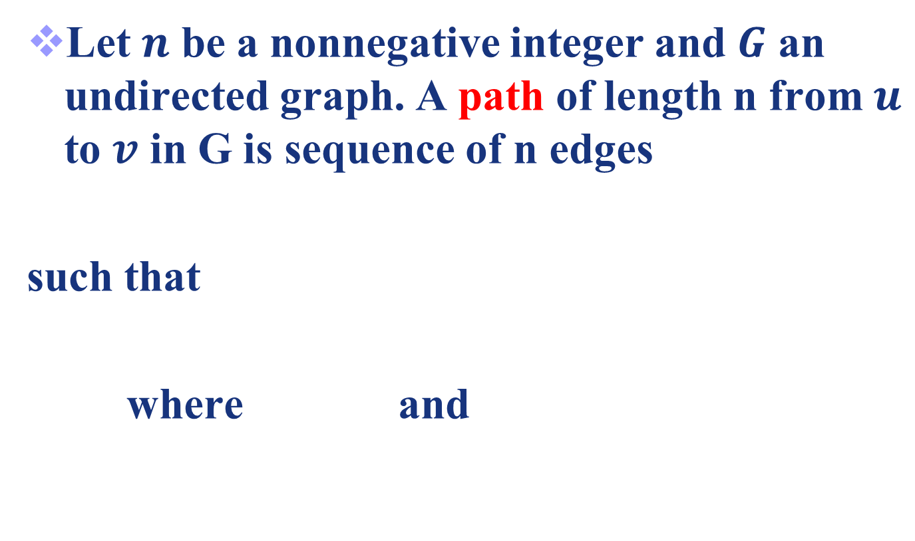
Definition 1 （ undirected grap）
Let $n$ be a nonnegative integer and $G$ an undirected graph. A path of length n from $u$ to $v$ in G is sequence of n edges
such that
where and

Slide 7
Definition 1 （ undirected grap）
A path is denoted as , where
A path of length zero consist of a single vertex.
When graph is simple, we denote this path by its vertex sequence
The list of the vertices uniquely determines the path.

Slide 8
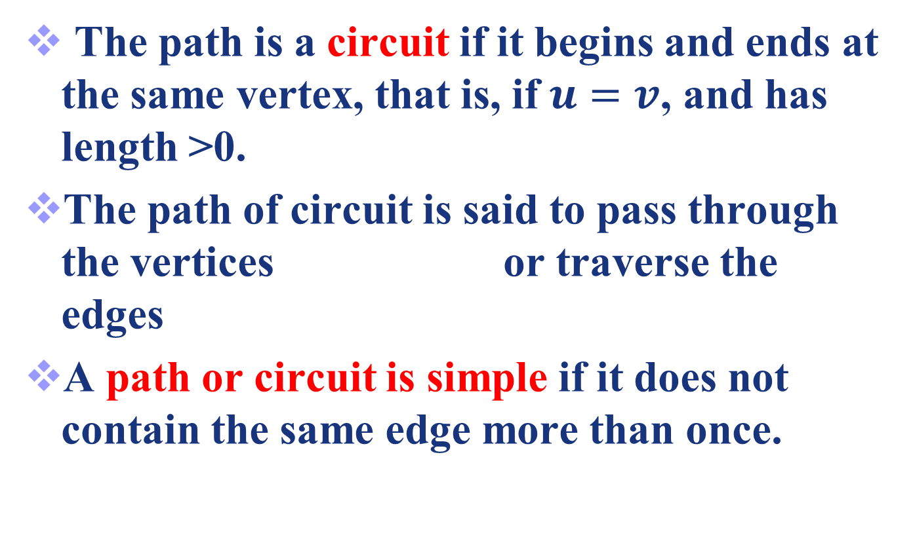
Definition 1 （undirected graph）
The path is a circuit if it begins and ends at the same vertex, that is, if $u=v$, and has length >0.
The path of circuit is said to pass through the vertices or traverse the edges
A path or circuit is simple if it does not contain the same edge more than once.

Slide 9
Example 1
a
b
c
d
e
f
a,d,c,f,e is a simple path of length 4.
d,e,c,a is not a path
b,c,f,e,b is a circuit of length 4.
a,b,e,d,a,b is of length 5 but not simple.

Slide 10
Example 2
Paths in Acquaintanceship Graphs
There is a chain of six people linking Kamini and Ching.
Eduardo
Jan
Paula
Todd
Kamlesh
Amy
Kamini
Lila
Liz
Steve
Ching
Joel
Gail
Koko
Kari
Shaquira

Slide 11
Many social scientist have conjectured that almost every pair of people in the world are linked by a small chain of people, perhaps contains ≤ 5 people.
This would mean that almost every pair of vertices in the acquaintanceship graph containing all people in the world is linked by a path of length ≤ 4.
John Guare : 6 Degree of Separation

Slide 12
Definition 2 （directed graph）
Let n be a nonnegative integer and G an directed multigraph graph.
A path of length n from u to v in G is sequence of n edges e1,…,en of G
such that f(e1)=(x0,x1), f(e2)=(x1,x2), …, f(en)=(xn-1,xn), where x0=u and xn=v.

Slide 13
Definition 2 （directed grap）
When there are no multiple edges in the directed graph, this path is denoted by its vertex sequence x0,x1,…,xn.
The path is a circuit or cycle if it begins and ends at the same vertex, that is, if u=v, and has length greater than zero.
A path or a circuit is called simple if it does not contain the same edge more than once.

Slide 14
Definition 2（directed graph）
The terminal vertex of an edge in a path is the initial vertex of the next edges in the path.
When it is not necessary to distinguish between multiple edges, we will denote a path e1,e2,…,en where f(ei)=(xi-1,xi) for i=1,2,…,n by its vertex sequence x1,x1,…,xn.
The notation identifies a path only up to the vertices it passes through.
There may be more than one path that passes through this sequence of vertices.

Slide 15
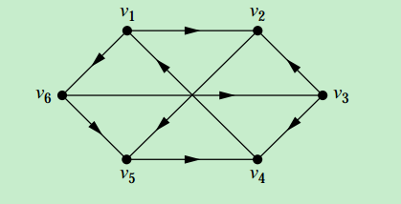

Slide 16
Simple circuit
Is path (e1,e2,e3) a simple circuit?
Answer: Yes
要点: 没有重复的边出现, e1,e2,e3是3条不同的边
e1
e2
e3

Slide 17
Connectedness
17

Slide 18

An important question
Definition 3: An undirected graph is called connected if there is a path between every pair of distinct vertices of the graph.
Any two computer in the network can communicate if and only if the graph of this network is connected.

Slide 19
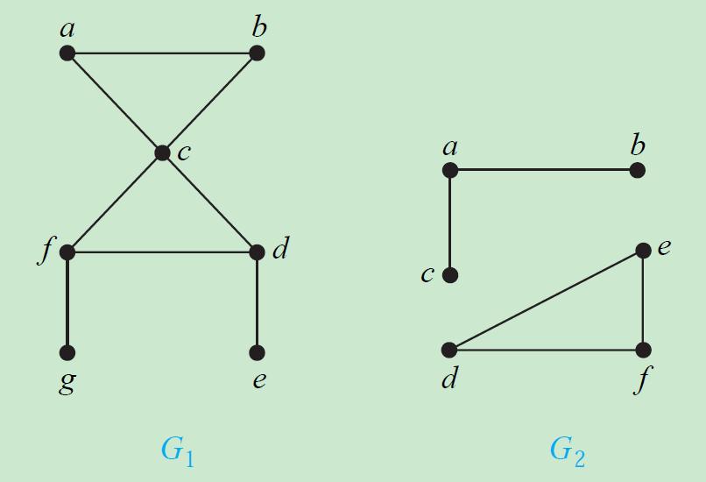
Example 5
G1 is connected, since every pair of distinct vertices there is a path between them.
G2 is not connected for there is no path in G2 between a and d for instance.

Slide 20
Theorem 1
Theorem 1 There is a simple path between every pair of distinct vertices of a connected undirected graph.

Slide 21
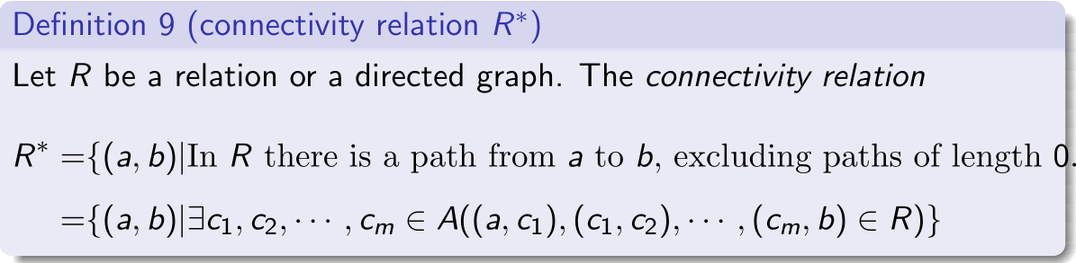
Recall lemmas on R*
.
Lemma: Let A be a set such that |A|=n, and let R be a relation on A. If a ≠ b, then there is such a path with length ≤ n-1.

Slide 22
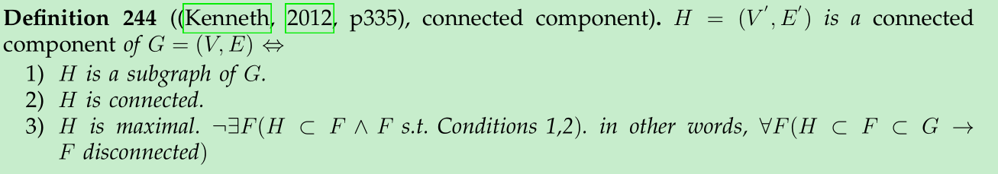
connected components
A graph that is not connected is the union of two or more connected subgraphs, each pair of which has no vertex in common.
These disjoint connected subgraphs are called the connected components of the graph.

Slide 23
Example 6
Subgraphs H1, H2 and H3 are the connected components of H.
b
d
e
f
H2
a
c
h
g
H
H3
H1

Slide 24
connected components
Consider the relation:
R={(a,b)| a,b are in the same
connected component }

Slide 25
cut vertices
Definition. The removal of a vertex and all edges incident with it produces a subgraph with more connected components than in the original graph. Such vertices are called cut vertices. 割点
a
d
f
g
b
c
e
h
The cut vertices?
b, c and e.

Slide 26
cut edge
Definition. An edge whose removal produces a graph with more connected components than in the original graph is called a cut edge 割边 or bridge 桥.
a
d
f
g
b
c
e
h
The cut edges ?
{a, b} and {c, e}.

Slide 27

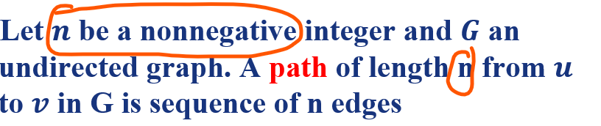
Connectedness in Directed Graphs
Definition 4: An directed graph is strongly connected if there is a path from a to b and from b to a, whenever a and b are vertices in the graph. Formally,
注意: path长度可以为0, R*不含长度为0的path.

Slide 28
Example 9
a
b
a
b
c
c
e
d
e
H
d
G
a
a
K
J
Which are strongly connected? G,K,J
28

Slide 29
A directed graph can fail to be strongly connected but still be in “one piece”.
Definition 5 makes this notion precise.
Definition 5: A directed graph is weakly connected if there is a path between every two vertices in the underlying undirected graph.

Slide 30
Example 10
a
b
a
b
c
c
e
d
e
H
d
G
a
a
K
J
Which are weakly connected? all
30

Slide 31
Strong connected and weakly connected
Any strongly connected directed graph is also weakly connected.

Slide 32
The maximal strongly connected subgraphs, are called the strongly connected components or strong component of G.
a
b
1、Vertex a
2、Vertex e
3、Graph consisting of vertices b, c and d and edges (b, c), (c, d) and (d, b)
a
b
c
c
e
d
e
d

Slide 33
Paths and Isomorphism
33

Slide 34
Graph Invariants under Isomorphism
If G₁=(V₁, E₁) ~ G₂=(V₂, E₂), then:
|V1|=|V2|
|E1|=|E2|.
The number of vertices with degree n is the same in both graphs.
For every proper subgraph g₁ ⊆ G₁, there is a proper subgraph g₂ ⊆ G₂ that g₂ ~ g₁.
Necessary conditions.

Slide 35
Graph Invariants under Isomorphism
4. If G₁=(V₁, E₁) ~ G₂=(V₂, E₂), then:
For every proper subgraph g₁ ⊆ G₁, there is a proper subgraph g₂ ⊆ G₂ that g₂ ~ g₁.
The cases
g₁ is a path of length k.
g₁ is a circuit of length k.
can help determine whether two graphs are isomorphic.

Slide 36
Example 12
u1
v1
u6
u2
v6
v2
u5
u3
v5
v3
u4
v4
G
H
6 vertices, and 8 edges.
4 vertices of degree 3, and 3 vertices of degree 2.
Three invariants - all agree for two graphs.

Slide 37
Example
We can also use paths to find mappings that are potential isomorphsms.
u1
v1
u1
v5
v2
u2
u5
u4
v4
v3
G
H

Slide 38
Count paths between vertices
how to compute the number of paths of length r between two vertices (i,j)?
Theorem 2: Let G be a ( directed or not) graph. v₁,v₂,…,v_{n} are its vertexes. A is its
adjacency matrix.
Let be number of path(i,j) of length r.
Let be the (i, j)th entry of (arithmetic operation).
Then

Slide 39
Example 14
a
b
d
c
a,b,a,b,d; a,b,a,c,d;
a,b,d,b,d;a,b,d,c,d;
a,c,a,b,d;a,c,a,c,d;
a,c,d,b,d;a,c,d,c,d;

Slide 40
Proof.

Slide 41
Question?
Given a graph, design algorithms to solve the following questions.
whether is it connected?
whether a given vertex pair (i,j) is connected?
how many paths connecting a given vertex pair (i,j)?

Slide 42
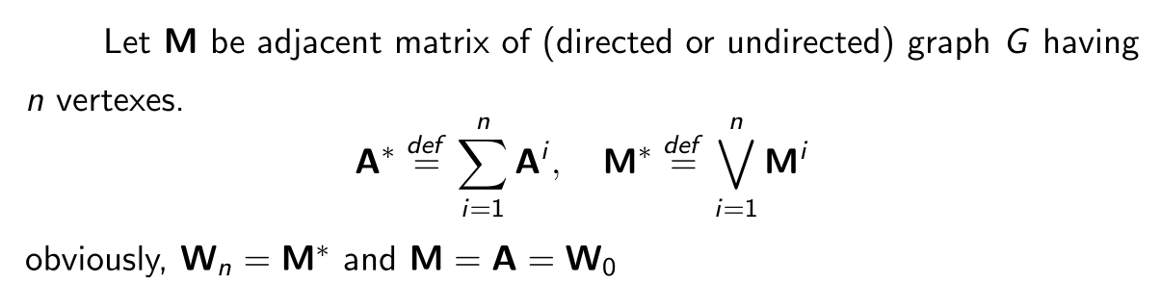
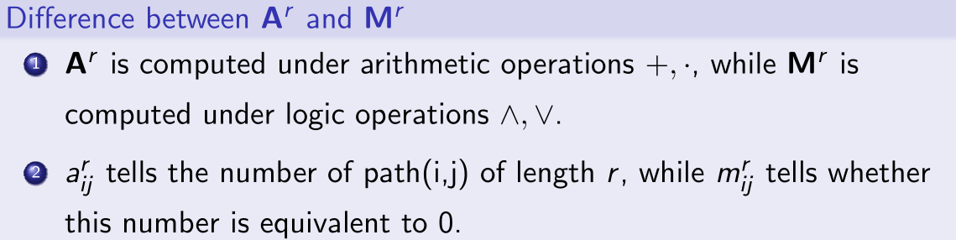
Something should not be confused

Slide 43
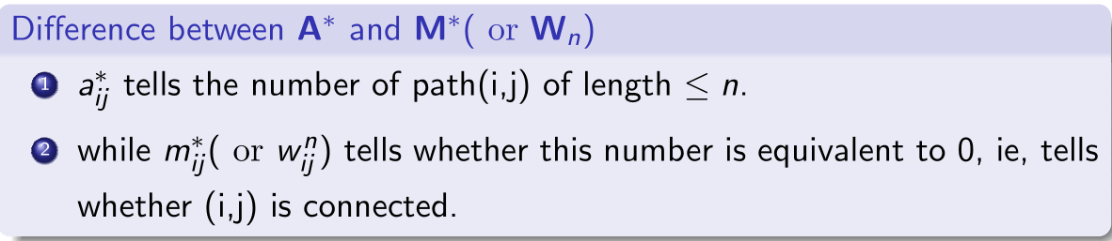
Something should not be confused

Slide 44
Homework
6a, 8, 10, 17

Slide 45
End of Section 8.4
Click to edit company slogan .
45

